Slide 1

NETWORK MODELS
SCHOOL OF DATA SCIENCE AND FORECASTING
DEVI AHILYA VISHWAVIDYALAYA, INDORE

Slide 2
Network Models
There is a multitude of operations research situations that can be modeled and solved as networks (nodes connected with branches). Possible applications of networks:
Design of an offshore natural gas pipeline network.
Determination of the shortest route between two cities in a network of roads.
Determination of maximum capacity of a coal slurry pipeline network joining the coal mines to power plants.
Determination of the minimum cost flow schedule from oil fields to refineries through a pipeline network.
Determination of the time schedule for the activities of a construction project.
Network Optimization Algorithms:
Minimal spanning tree
Shortest-route algorithm
Maximum flow algorithm
Project Scheduling algorithms

Slide 3
Network Definitions
Network: A network consists of a set of nodes connected by arcs.
Notation: (N,A), where N is the set of nodes, A is the set of arcs.
N = {1,2,3,4,5}
A = {(1,2), (1,3),(2,3),(2,5),
(3,4),(3,5),(4,2),(4,5)}
Each network represents some type of flow e.g. gas flow, oil flow, traffic flow on road network, etc. In general flow in a network is limited by the capacity of its arcs.
An arc is said to be directed if it allows positive flow in one direction and zero flow in opposite direction. A directed network has all directed arcs.
A path is a sequence of distinct arcs that join two nodes through other nodes regardless of the direction of flow in each arc. A path forms a cycle if it connects a node to itself through other nodes. Arcs (2,3), (3,5), (5,2) form a loop (regardless of direction). Arcs (2,3), (3,4), (4,2) form a directed loop or cycle.
A connected network is such that every two distinct nodes are connected by at least one path.
3
5
1
2
4

Slide 4
Network Definitions
Tree: A tree is a connected network that may involve only a subset of all the nodes of the network without cycles.
Tree with n nodes contains exactly n-1 arcs.
A
B
C
D
E
F
Spanning Tree: Spanning tree is a tree that connect all the nodes of the network, also with no cycles allowed.
A connected, undirected graph
Four of the spanning trees of the graph

Slide 5
MINIMAL SPANNING TREE
A network problem with the objective of connecting all the nodes in the network while minimizing the total length required to do so.
Examples: Construction of road network with minimum length and connecting several towns. Connecting several houses with most economical cable network.
Minimizing the Cost:
Suppose you want to supply a set of houses (say, in a new subdivision) with: electric power, water, sewage lines, telephone lines, etc.
To keep costs down, you could connect these houses with a spanning tree (of, for example, power lines). However, the houses are not all equal distances apart. To reduce costs even further, you could connect the houses with a minimum-cost spanning tree.

Slide 6
MINIMAL SPANNING TREE ALGORITHM
The steps of the procedure to find out Minimal Spanning Tree are as follows:
Let,
N = {1,2,3,….,n} be the set of nodes of the network.
A_{k} = Set of the nodes that have been permanently connected at iteration k.
Ā_{k}= Set of the unconnected nodes at iteration k.
Step 0: Set A₀ = Ø and Ā₀ = N
Step 1: Start with any node (i) in the unconnected set Ā₀ and set A₁ = {i}, which renders Ā₁ = N-{i}, set k = 2.
General Step k: Select a node j in the unconnected set Ā_{k-1} that yields the shortest arc to a node in the connected set A_{k-1}. Link node j permanently to A_{k-1} and remove it from set Ā_{k-1}, that is,
A_{k} = A_{k-1} + {j}, Ā_{k} = Ā_{k-1}- {j}
If the set of unconnected nodes, Ā_{k}, that is empty, stop. Otherwise, set k=k+1 and repeat the step.

Slide 7
MINIMAL SPANNING TREE ALGORITHM
Steps:
1. Select any node in the network.
2. Connect this node to the nearest node that minimizes the total distance.
3. Considering all the nodes that are now connected, find and connect the nearest node that is unconnected. If there is a tie, select one arbitrarily. A tie suggests there may be more than one optimal solution.
4. Repeat the third step until all nodes are connected.

Slide 8
MINIMAL SPANNING TREE (Example)
Problem: A TV cable company is in process of providing cable service to five new housing complexes. The figure shows possible TV linkages among the five complexes. The cable length (Km.) is shown on each arc. Determine the most economical cable network.
2
3
6
9
5
1
4
1
5
3
8
5
10
7
4
6
3

Slide 9
MINIMAL SPANNING TREE (Example)
Solution:
Iteration 1: Algorithm starts from any node, say 1, which gives
A₁ = {1}, Ā₁ = {2,3,4,5,6}
Iteration 2: From node 1 arc (1,2) is the shortest link among all the arcs connected to Node 1. Make it permanent, which gives
A₂ = {1,2}, Ā₂ = {3,4,5,6}
2
3
5
1
4
1
5
3
Arc (1,3) and Arc (3,4) are Alternate Links.
5
4
6
3
Minimal Spanning Tree
Iteration 3: Select the shortest arc connecting permanently connected nodes (1,2) with unconnected nodes (3,4,5,6). Arc (2,5) is the shortest. Connect it to node 2 permanently, which gives A₃ = {1,2,5}, Ā₃ = {3,4,6}
Iteration 4: Select the shortest arc connecting permanently connected nodes (1,2,5) with unconnected nodes (3,4,6). Arc (2,4) is the shortest. Connect it to node 2 permanently, which gives A₄ = {1,2,4,5}, Ā₄ = {3,6}
Iteration 5: Select the shortest arc connecting permanently connected nodes (1,2,4,5) with unconnected nodes (3,6). Arc (4,6) is the shortest. Connect it to node 4 permanently, which gives A₅ = {1,2,4,5,6}, Ā₅ = {3}
Iteration 6: Select the shortest arc connecting permanently connected nodes (1,2,4,5,6) with unconnected node (3). Arc (3,4) or arc (1,3) are the shortest. Connect either one permanently, Alternate Solution exist, which gives A₆ = {1,2,3,4,5,6}, Ā₆ = Ø.
Length of the required minimum cable = 1+3+4+3+5 = 16 Km.

Slide 10
MINIMAL SPANNING TREE (Example)-SUMMARY
Steps | Connected Nodes | Unconnected Nodes | Closest Unconnected Node | Arc Selected | Arc Length (Km.) | Total Length (Km.)
1 | 1 | 2,3,4,5,6 | 2 | 1-2 | 1 | 1
2 | 1,2 | 3,4,5,6 | 5 | 2-5 | 3 | 4
3 | 1,2,5 | 3,4,6 | 4 | 2-4 | 4 | 8
4 | 1,2,4,5 | 3,6 | 6 | 4-6 | 3 | 11
5 | 1,2,4,5,6 | 3 | 3 | 1-3 or 3-4 | 5 | 16
6 | 1,2,3,4,5,6 | - | - | - | - | 16

Slide 11
Shortest Route Algorithm
In the shortest-route problem, the objective is to find the shortest distance from one location (origin) to another location (destination) through a network.
The algorithm used to solve the shortest-route problem assumes that all node distances are non-negative. The algorithm finds the shortest route from a specified node (usually node 1) to every node in the network. The algorithm requires n-1 steps, where n is the number of nodes in the network.
Algorithms:
Dijkstra’s Algorithm
Floyd’s Algorithm
Dijkstra’s algorithm is designed to determine the shortest routes between the source node and every other node in the network. Floyd’s algorithm is general because it allows the determination of the shortest route between any two nodes in the network.

Slide 12
Dijkstra’s Algorithm
Let u_{i} is the shortest distance from source node 1 to node i, dij (≥0) is the length of arc (i,j). The algorithm defines the label for an immediately succeeding node j as [u_{j},i] = [u_{i} + d_{ij},i], d_{ij}≥0
The label consists of two numbers, separated by a comma. The first number refers to the distance from node 1 to the labeled node along a certain path, while the second number refers to the node that immediately precedes this node along the path.
The label for the starting node is [0,-], indicating that the starting node has no predecessor. This node is considered to be permanently labeled.
Labels are of two types: temporary and permanent.
A temporary label is modified if a shorter route to a node can be found. At the point when no better routes can be found, the status of the temporary label is changed to permanent.
Once the algorithm has been completed, the shortest route to any given node from node 1 can be found by tracing the node labels back through the network.

Slide 13
Dijkstra’s Algorithm
Step 0:
Label the source node (node 1) with the permanent label [0,-], Set i=1.
Step i:
(a) Compute the temporary labels [u_{i}+d_{ij},i] for each node j that can be reached directly from node i, provided j is not permanently labeled. If node j already labeled with [u_{j},k] through another node k and if u_{i}+d_{ij}<u_{j}, replace [u_{j},k] with[u_{i}+d_{ij},i].
(b) If all the nodes have permanent labels, stop. Otherwise, select the label [u_{r},s] having the shortest distance (=u_{r}) among all the temporary labels (break ties arbitrarily) as permanent label. Set i=r and repeat step i.

Slide 14
Dijkstra’s Algorithm (Example)
[100,1]
The network gives the routes and their lengths in Km. between city 1 (node 1) and four other cities (node 2 to 5). Determine the shortest routes between city1 and each of the remaining four cities.
15
2
4
100
50
20
10
[0,-]
1
5
30
3
60
Iteration 0: Assign permanent label [0,-] to node 1.
Determine temporary labels for every node that can be reached directly from node 1. Nodes 2 and 3 can be reached directly from node 1. The labels of nodes 2 and 3 can be written as shown in the table.
[30,1]
Node | Label | Status
1 | [0,-] | Permanent
2 | [0+100,1] = [100,1] | Temporary
3 | [0+30,1] = [30,1] | Temporary

Slide 15
Dijkstra’s Algorithm (Example)
Iteration 1:
Determine which temporary label has the smallest distance from node 1. It is node 3 with a distance (u₃=30). Thus, the status of node 3 is changed to permanent.
Now determine temporary labels for each node that can be reached directly from latest permanent node unless a node already has a permanent label (e.g. node 1) or unless a current temporary label already exists that cannot be improved on.
Nodes 4 and 5 can be reached directly from node 3, and the labels will be [40,3] and [90,3] as shown in the table.
[100,1]
15
[40,3]
2
4
100
50
20
10
[0,-]
1
5
30
3
60
[90,3]
[30,1]
Node | Label | Status
1 | [0,-] | Permanent
2 | [0+100,1] = [100,1] | Temporary
3 | [30,1] | Permanent
4 | [30+10,3] = [40,3] | Temporary
5 | [30+60,3] = [90,3] | Temporary

Slide 16
Dijkstra’s Algorithm (Example)
Iteration 2:
Identify the node that has the smallest temporary label. Node 4 gives shortest distance (u₄=40). Thus, the status of node 4 is changed to permanent.
Find non-permanent nodes that can be reached directly from the newest permanent node 4. These are 2 and 5.
Temporary label of node 2 is updated as [55,4] from [100,1] as shorter route is found from node 4.
Node 5 has two alternate labels with same distance.
[100,1]
15
[40,3]
[55,4]
2
4
100
50
20
10
[0,-]
1
5
[90,4]
30
3
60
[90,3]
[30,1]
Node | Label | Status
1 | [0,-] | Permanent
2 | [40+15,4] = [55,4] | Temporary
3 | [30,1] | Permanent
4 | [40,3] | Permanent
5 | [90,3] or [40+50,4]=[90,4] | Temporary

Slide 17
Dijkstra’s Algorithm (Example)
Iteration 3:
Identify the node that has the smallest temporary label. Node 2 gives shortest distance (u₂=55). Thus, the status of node 2 is changed to permanent.
Only node 3 can be reached directly from node 2. But, node 3 already has permanent label and cannot be relabeled.
[100,1]
[40,3]
[55,4]
15
2
4
100
50
20
10
[0,-]
1
5
[90,3]
30
3
[90,4]
60
Node | Label | Status
1 | [0,-] | Permanent
2 | [55,4] | Permanent
3 | [30,1] | Permanent
4 | [40,3] | Permanent
5 | [90,3] or [90,4] | Temporary
[30,1]

Slide 18
Dijkstra’s Algorithm (Example)
Iteration 4:
Now node 5 is the only temporary labeled node. Because node 5 does not lead to any other node. Its status is converted to permanent, and the process ends.
Summary of Shortest Routes:
[100,1]
[40,3]
[55,4]
15
2
4
100
50
20
10
[0,-]
1
5
[90,3]
30
3
[90,4]
60
[30,1]
Node | Distance | Shortest Route | Alternate Route
2 | 55 | 1-3-4-2 | -
3 | 30 | 1-3 | -
4 | 40 | 1-3-4 | -
5 | 90 | 1-3-5 | 1-3-4-5
Node | Label | Status
1 | [0,-] | Permanent
2 | [55,4] | Permanent
3 | [30,1] | Permanent
4 | [40,3] | Permanent
5 | [90,3] or [90,4] | Permanent

Slide 19
MAXIMUM FLOW PROBLEM
In a maximum flow problem, the objective is to maximize flow through a network.
Examples: system of roads and highways, systems of pipelines that carry natural gas, oil, water, airline routes, etc.
In order to determine the maximum flow of a system, it is necessary to take into account the flow capacities of the various branches of a network. Branch capacities limit the rate of flow through a branch (arc) of the network. Hence, the objective is to determine the amount of flow through each branch that will achieve the maximum possible flow for the system as a whole.
It is assumed that there is a single input node (source) and single output node (sink). There is flow conservation, means that the flow of any node is equal to the flow into that node.

Slide 20
MAXIMUM FLOW PROBLEM
Node 1 is the input node
Node 4 is the output node.
The numbers on the branches indicate the flow capacity of a branch in given direction. 0 indicates no flow in that direction.
Branch 2-3: Maximum flow is 2 in either direction.
Flow cannot occur simultaneously in both directions. For any branch flow can occur in one direction only, even though it may be allowable in both directions.
0
2
6
10
2
0
Input
10
Output
Sink
1
4
Source
3
2
0
0
6
3

Slide 21
MAXIMUM FLOW ALGORITHM
Steps:
1. Find any path from source node to the sink node that has a positive flow capacity. Flow capacity of a path is determined by the smallest branch capacity along the path chosen in the direction of flow. If no such path can be found, the current solution is optimal. If no such path is found at the start, no flow is possible (infeasible solution).
2. Adjust the flow capacities of the branches on the chosen path. For each branch, at the end where the flow enters, reduce the capacity by the amount of flow; at the end where flow leaves, increase the capacity by the amount of flow.
3. Return to step 1.
0
2
6
10
2
0
Input
10
Output
Sink
1
4
Source
3
2
0
0
6
3
1
2
1
3
0
3
Number 3 at left shows that max. 3 units of flow can take place from 1 to 3. Number 0 at right shows that no flow is possible from node 3 to 1. Assume 2 units are flown from node 1 to 3. Then adjustment will be as shown in the fig. No flow is possible from 3 to 1, number 2 at right shows that is quantity can be reversed (increase at 1 and decrease at 3).

Slide 22
MAXIMUM FLOW ALGORITHM (Example)
Select any path from source node to sink node (say, 1-2-4). Max. possible flow = 6
Adjustment of flow. Branch 2-4 is fully loaded.
Explore further flow from 1 to 2 (if possible) or search a new path.
Select path 1-2-3-4. Flow of 2 units is possible. No further flow is possible through path 1-2-3-4.
Select another path 1-3-4. Max. possible flow is 3 units. Update accordingly.
There is no path having positive flow. Therefore, it is optimum flow through this network.
2
8
6
0
2
6
0
2
6
4
6
6
10
0
0
6
2
2
Input
1
10
Output
Sink
6+2+3
4
6+2+3
Source
0
3
2
2
0
3
4
6
₀
2
5
3
3
4
3
1

Slide 23
MAXIMUM FLOW ALGORITHM (Example)
Final Solution
2
6
8
Input
2
Output
Sink
11
1
4
11
Source
3
5
3

Slide 24
NETWORK PROJECT
Any project is comprised of a unique set of activities established to achieve a given set of objectives during a limited life span. Examples-
The projects may be extremely large and complex such as construction of a housing, a highway, a shopping complex, etc. Introduction of new products, research and development projects, etc.
The project involves planning, scheduling and controlling a number of interrelated activities with use of limited resources, e.g. men, machines, materials, money and time.
It is required that managers must have a dynamic planning and scheduling system to produce the best possible results and also to react immediately to the changing conditions and make necessary changes in the plan and schedule.

Slide 25
Network Representation
A project involves planning, scheduling and controlling a number of interrelated activities with use of limited resources, namely, men, machines, materials, money and time. The projects may be extremely large and complex such as construction of a housing , a highway, a shopping complex etc.
Each activity of the project is represented by an arc pointing in the direction of progress in the project.
Activity: An activity represents an action and consumption of resources (time, money, energy) required to complete a portion of a project. Activity is represented by an arrow.
Event: An event (or node) will always occur at the beginning and end of an activity. The event has no resources and is represented by a circle. The i^{th} event and j^{th} event are the tail event and head event respectively.
i
A
j
A: Activity, i & j events

Slide 26
Network Representation
One or more activities can start or end simultaneously at an event.
Merge Event
Burst Event
Activities performed before given event are known as preceding activities and the activities performed after a given event are known as succeeding activities.
Dummy Activity: An imaginary activity which does not consume any resource and time is called a dummy activity. Dummy activities are simply used to represent a connection between events in order to maintain a logic in the network. It is represented by a dotted line in a network.

Slide 27
Rules for Constructing the Network
Rule 1: Each activity is represented by one and only one arc.
Rule 2: Each activity must be identified by two distinct end nodes. If not, use dummy activity to separate end nodes.
Incorrect Correct
Rule 3: To maintain the correct precedence relationships, the following questions must be answered as each activity is added to the network:
What activities must immediately precede the current activity?
What activities must follow the current activity?
What activities must occur concurrently with the current activity?
Example: Consider following segment of a project:
Activity C starts immediately after A and B have been completed.
Activity E starts after only B has been completed.
A
2
A
D
1
1
2
B
B
3
A
C
A
C
Wrong
D
Correct
B
E
B
E

Slide 28
Construction of a Network (Example 1)
A company is in the process of preparing a budget for launching a new product. The following table provides the associated activities and their durations. Construct the project network.
Network
Activity | Predecessor(s) | Duration (Days)
A: Forecast sales volume | - | 10
B: Study competitive market | - | 7
C: Design time and facilities | A | 5
D: Prepare production schedule | C | 3
E: Estimate cost of production | D | 2
F: Set sales price | B,E | 1
G: Prepare budget | F | 14
C
D
A
2
4
5
E
G
1
B
F
6
7
3

Slide 29
Construction of a Network (Example 2)
Construct a network for a project whose activities and their predecessor relationships are given below:
A, B and C are the first activities of the project, can be executed concurrently.
A and B precede D
B precedes E,F and H
F and C precede G
E and H precede I and J
C,D,F and J precede K
K precedes L
I, G and L are the terminal activities.
Network
D
A
2
D₁
5
D₂
K
1
B
E
J
7
8
3
H
6
C
D₃
F
L
4
I
G
9

Slide 30
Critical Path Computations
CPM (Critical Path Method) and PERT (Program Evaluation and Review Technique) are two of the most widely used techniques for planning and coordination of large-scale projects. By using CPM or PERT, the managers are able to obtain:
A graphical display of the project activity.
An estimate of how long the project will take.
An indication of which activities are the most critical to timely completion of the project.
An indication of how long any noncritical activity can be delayed without delaying the entire project.
CPM and PERT were developed independently during the late 1950s. CPM was developed by Remington Rand Corporation and Du Pont to plan and coordinate maintenance projects in chemical plants. PERT was evolved through joint efforts Lockheed Aircraft, U S Navy, and the consulting firm Booz, Allen & Hamilton in an effort to speed up the Polaris missile project.
Both CPM and PERT have similarity in terms of concepts. However, initially there were differences in measuring duration of the activities. CPM has single (deterministic) time estimates of the project activities while PERT has three (probabilistic) time estimates of the project activities and uses probability theory to find the chance of completing the project in the scheduled time.
At present, either technique can be used with deterministic or probabilistic time estimates.

Slide 31
CRITICAL PATH METHOD (CPM)
CPM provides the following information:
Total duration needed to complete the project.
Classification of the activities of the project as critical and noncritical.
An activity is said to be critical if there is no “leeway” in determining its start and finish times. The critical activity does not have any slack time.
A noncritical activity allows some scheduling slack, so that start time of the activity may be advanced or delayed within limits without affecting the completion date of the entire project.

Slide 32
CRITICAL PATH METHOD
The Critical Path calculations involve two phases:
The forward pass determines the earliest occurrence times of the events.
The backward pass calculates the latest occurrence times.
Forward Pass:
The forward pass is used to calculate the Earliest Occurrence Time (ET) of the event at which the activities originating from this event can be started.
Step 1: Begin from the start event and move towards the end event.
Step 2: Put ET = 0 for the start event (indicating that the project starts at time 0).
Step 3: Go to the next event (say, j) if there is an incoming activity at event j from event i, and calculate ET_{j} as ET_{j} = ET_{i} + D_{ij}, where D_{ij} is the duration of the activity (i,j).
Note: If there are more than one incoming activities at event j, calculate ET for all incoming activities and take the maximum one as ET_{j}.
Step 4: Repeat the same procedure of Step 3 till the end event.

Slide 33
CRITICAL PATH METHOD
Backward Pass:
The backward pass is used to calculate the Latest Occurrence Time (LT) of the event at which the activities terminating at the event can be completed.
Step 1: Begin from end event and move towards the start event.
Step 2: Assume that the earliest and latest occurrences of the last event of the project are same.
Step 3: Go to the next event (say, j) in the backward direction, if there is an outgoing activity from event j to event k, and calculate LT_{j} as LT_{j} = LT_{k} - D_{jk}, where D_{jk} is the duration of the activity (j,k).
Note: If there are more than one outgoing activities from event j, calculate LT for all outgoing activities and take the minimum one as LT_{j}.
Step 4: Repeat the same procedure of step 3 till the start event.

Slide 34
CRITICAL PATH METHOD
Critical Activity:
An activity (i,j) will be critical if it satisfies the following three conditions:
ET_{i} = LT_{i}
ET_{j} = LT_{j}
ET_{j} - ET_{i} = LT_{j}- LT_{i} = D_{ij}
The three conditions state that the earliest and latest occurrence times of nodes i and j are equal, and the duration D_{ij} fits tightly in the specified time span.
Noncritical Activity:
An activity that does not satisfy all three conditions given above is noncritical.

Slide 35
CRITICAL PATH METHOD (Example)
Determine the critical path for the project network. All durations are in days.
Critical Path Calculations:
Forward Pass:
Node 1: Set ET₁ = 0
Node 2: ET₂ = ET₁ + D₁₂ = 0 + 5 = 5
Node 3: ET₃ = Max. (ET₁+D₁₃, ET₂+D₂₃)
= Max. (0+6, 5+3) = 8
Node 4: ET₄ = ET₂ + D₂₄ = 5 + 8 = 13
Node 5: ET₅ = Max. (ET₃+D₃₅, ET₄+D₄₅)
= Max. (8+2, 13+0) = 13
Node 6: ET₆ = Max. (ET₃+D₃₆, ET₄+D₄₆, ET₅+D₅₆)
= Max. (8+11, 13+1, 13+12) = 25
ET₃ | 8
LT₃
3
F-11
ET₆ | 25
LT₆
ET₁ | 0
LT₁
B-6
E-2
6
1
H-12
C-3
ET₅ | 13
LT₅
5
A-5
D₁-0
G-1
4
ET₂ | 5
LT₂
2
D-8
ET₄ | 13
LT₄

Slide 36
CRITICAL PATH METHOD (Example)
Determine the critical path for the project network. All durations are in days.
Critical Path Calculations:
Backward Pass:
Node 6: Set LT₆ = ET₆ = 25
Node 5: LT₅ = LT₆ – D₅₆ = 25 - 12 = 13
Node 4: LT₄ = Min. (LT₅-D₄₅, LT₆-D₄₆)
= Min. (13-0, 25-1) = 13
Node 3: LT₃ = Min. (LT₅-D₃₅, LT₆-D₃₆)
= Min. (13-2, 25-11) = 11
Node 2: LT₂ = Min. (LT₃-D₂₃, LT₄-D₂₄)
= Min. (11-3, 13-8) = 5
Node 1: LT₁ = Min. (LT₂-D₁₂, LT₃-D₁₃)
= Min. (5-5, 11-6) = 0
Correct calculations will always end with LT₁ = 0
ET₃ | 8
LT₃ | 11
3
F-11
ET₆ | 25
LT₆ | 25
ET₁ | 0
LT₁ | 0
B-6
E-2
6
1
H-12
C-3
ET₅ | 13
LT₅ | 13
5
A-5
D₁-0
G-1
4
ET₂ | 5
LT₂ | 5
2
D-8
ET₄ | 13
LT₄ | 13

Slide 37
CRITICAL PATH METHOD (Example)
Determine the critical path for the project network. All durations are in days.
Critical Path Calculations:
Critical Activities:
The following activities satisfy the given three conditions of critical activities:
A, D, D₁, H
Noncritical Activities:
The other activities-B, C, E, F, G do not satisfy all three conditions. Hence, these activities are non-critical activities.
Critical Path:
1 2 4 5 6
Or A D D1 H
The sum of the durations of all critical activities equals the duration of the project = 25 days.
ET₃ | 8
LT₃ | 11
3
F-11
ET₆ | 25
LT₆ | 25
ET₁ | 0
LT₁ | 0
B-6
E-2
6
1
H-12
C-3
ET₅ | 13
LT₅ | 13
5
A-5
D₁-0
G-1
4
ET₂ | 5
LT₂ | 5
2
D-8
ET₄ | 13
LT₄ | 13

Slide 38
Determination of the Floats:
Floats are the slack times available within the allotted span of the noncritical activity. Two most common floats are – total float and free float.
Total Float:
The Total Float of the activity (i,j) is the excess of the time span defined from the earliest occurrence of event i to the latest occurrence of event j over the duration of the activity (i,j).
TF_{ij} = LT_{j} – ET_{i} – D_{ij}
Free Float:
The Free Float of the activity (i,j) is the excess of the time span defined from the earliest occurrence of event i to the earliest occurrence of event j over the duration of the activity (i,j).
FF_{ij} = ET_{j} – ET_{i} – D_{ij}
By definition, FF_{ij} ≤ TF_{ij}
For any critical activity FF_{ij} = TF_{ij} = 0

Slide 39
Determination of the Floats:
TF_{ij} = LT_{j} – ET_{i} – D_{ij}
FF_{ij} = ET_{j} – ET_{i} – D_{ij}
ET₃ | 8
LT₃ | 11
Activity | Status | Duration (Days) | Total Float | Free Float
A (1,2) | Critical | 5 | 0 | 0
B (1,3) | Noncritical | 6 | 5 | 2
C (2,3) | Noncritical | 3 | 3 | 0
D (2,4) | Critical | 8 | 0 | 0
D1 (4,5) | Dummy-Critical | 0 | 0 | 0
E (3,5) | Noncritical | 2 | 3 | 3
F (3,6) | Noncritical | 11 | 6 | 6
G (4,6) | Noncritical | 1 | 11 | 11
H (5,6) | Critical | 12 | 0 | 0
3
F-11
ET₆ | 25
LT₆ | 25
ET₁ | 0
LT₁ | 0
B-6
E-2
6
1
H-12
C-3
ET₅ | 13
LT₅ | 13
5
A-5
D₁-0
G-1
4
ET₂ | 5
LT₂ | 5
2
D-8
ET₄ | 13
LT₄ | 13

Slide 40
Construction of Time Schedule
For an activity (i,j), ET_{i} represents the earliest start time and LT_{j} represents latest completion time. It means that (ET_{i}, LT_{j}) delineates the maximum time span during which activity (i,j) may be scheduled.
Rules:
The critical activities must be scheduled one after another to ensure that the project is completed within its specified duration.
The noncritical activities have larger time spans than their respective durations, thus allowing slack (leeway) in scheduling them within their allotted spans.
Red-Flagging Rule: For a noncritical activity (i,j)-
(a) If FF_{ij} = TF_{ij}, then the activity can be scheduled anywhere within its (ET_{i}, LT_{j}) span without causing schedule conflict.
(b) If FF_{ij} < TF_{ij}, then the activity will be red flagged and the start of activity (i,j) can be delayed by at most FF_{ij} relative to its earliest start time (ET_{i}) without causing schedule conflict. Any delay larger than FF_{ij} (but not more than TF_{ij}) must be accompanied by an equal delay relative to ET_{j} in the start time of all the activities leaving node j.

Slide 41
Construction of Time Schedule
 | A-5
 |  |  |  |  |  |  |  |  | D-8
 |  |  |  |  |  |  |  |  |  |  |  |  |  |  |  |  |  |  | H-12
 |  | B-6
 |  |  |  |  |  |  |  | C-3
 |  |  |  |  |  |  |  |  |  |  | E-2
 |  |  |  |  |  |  |  |  |  |  |  |  |  |  |  |  |  | F-11
 |  |  |  |  |  |  |  |  |  |  |  |  |  |  |  |  |  |  | G-1
0 | 1 | 2 | 3 | 4 | 5 | 6 | 7 | 8 | 9 | 10 | 11 | 12 | 13 | 14 | 15 | 16 | 17 | 18 | 19 | 20 | 21 | 22 | 23 | 24 | 25
 |  |  |  |  |  |  |  |  |  |  | Days
 |  |  |  | Critical |  |  |  |  | Noncritical

Slide 42
PROGRAM EVALUATION AND REVIEW TECHNIQUE (PERT)
There are several situations in which single time estimate of the project activities is not appropriate and probabilistic time estimates are taken. PERT is used in such situation where three time estimates are taken instead of one:
Optimistic time: The length of time required under best (optimistic) conditions. It is represented by the letter a.
Pessimistic time: The length of time required under worst conditions. It is represented by the letter b.
Most-likely time: The most probable amount of time required under normal conditions. It is represented by the letter m.
The beta distribution is commonly used to describe the inherent variability in time estimates.

Slide 43
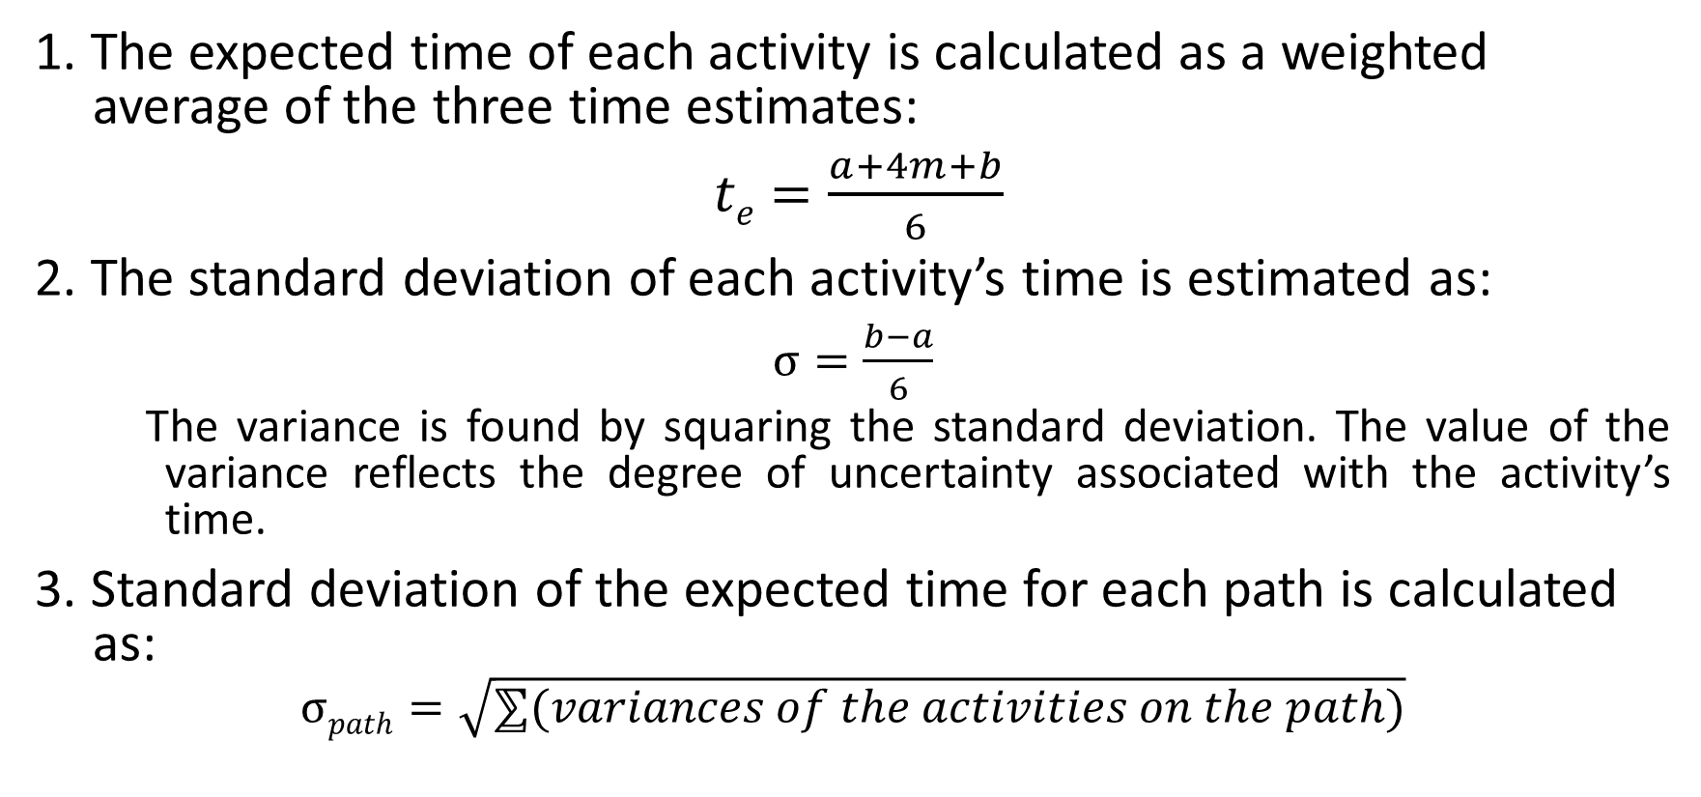
PROGRAM EVALUATION AND REVIEW TECHNIQUE (PERT)
1. The expected time of each activity is calculated as a weighted average of the three time estimates:
$te=\frac{a+4m+b}{6}$
2. The standard deviation of each activity’s time is estimated as:
$σ=\frac{b−a}{6}$
The variance is found by squaring the standard deviation. The value of the variance reflects the degree of uncertainty associated with the activity’s time.
3. Standard deviation of the expected time for each path is calculated as:
$$σpath=\sqrt{⅀(variances of the activities on the path)}$$

Slide 44
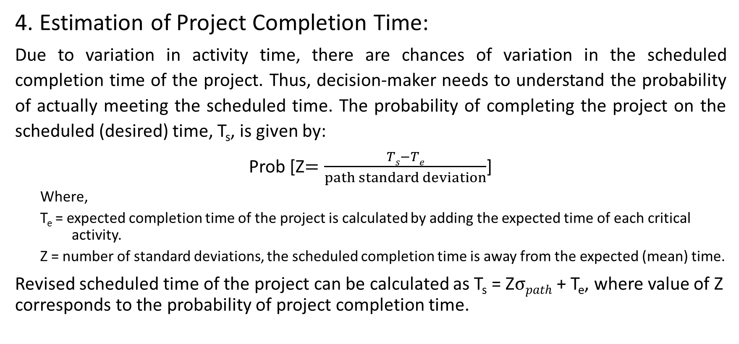
PROGRAM EVALUATION AND REVIEW TECHNIQUE (PERT)
4. Estimation of Project Completion Time:
Due to variation in activity time, there are chances of variation in the scheduled completion time of the project. Thus, decision-maker needs to understand the probability of actually meeting the scheduled time. The probability of completing the project on the scheduled (desired) time, T_{s}, is given by:
Prob [Z$=\frac{Ts−Te}{path standard deviation}$]
Where,
T_{e} = expected completion time of the project is calculated by adding the expected time of each critical activity.
Z = number of standard deviations, the scheduled completion time is away from the expected (mean) time.
Revised scheduled time of the project can be calculated as T_{s} = Z$σpath$ + T_{e}, where value of Z corresponds to the probability of project completion time.

Slide 45
PERT (Example)
Consider the following project:
Determine the followings:
Expected completion time and variance of each activity
The critical path
The probability to complete the project within 28 days of its start.
The probability to complete the project within 23 days of its start.
The probability not to complete the project within 23 days of its start.
The duration of the project that will have 95% chance of being completed.
Activity | i-j | Time Estimates (Days)
 |  | a | m | b
A | 1-2 | 3 | 5 | 7
B | 1-3 | 4 | 6 | 8
C | 2-3 | 1 | 3 | 5
D | 2-4 | 5 | 8 | 11
E | 3-5 | 1 | 2 | 3
F | 3-6 | 9 | 11 | 13
G | 4-6 | 1 | 1 | 1
H | 5-6 | 10 | 12 | 14

Slide 46

PERT (Example)
Solution:
(i)
Activity | i-j | Time Estimates (Days) |  |  | t_{e} | σ²
 |  | a | m | b
A | 1-2 | 3 | 5 | 7 | 5 | 0.444
B | 1-3 | 4 | 6 | 8 | 6 | 0.444
C | 2-3 | 1 | 3 | 5 | 3 | 0.444
D | 2-4 | 5 | 8 | 11 | 8 | 1.000
E | 3-5 | 1 | 2 | 3 | 2 | 0.111
F | 3-6 | 9 | 11 | 13 | 11 | 0.444
G | 4-6 | 1 | 1 | 1 | 1 | 0.000
H | 5-6 | 10 | 12 | 14 | 12 | 0.444
(ii). Critical Path
See the (i-j) relation and t_{e} (D_{ij}) of each activity are same as of the example taken in CPM.
Hence, critical path will be same as under CPM.
(iii). T_{s} = 28 days, T_{e} = 25 days
$$σcritical path=\sqrt{0.444+1+0.444}$$
= 1.3740
Prob [Z$=\frac{Ts−Te}{path standard deviation}$]
Prob [Z$=\frac{28−25}{1.3740}$] = P{Z ≥ 2.18} = 0.5+0.4854
The probability to complete the project within 28 days of its start = 0.9854 = 98.54%
Note that for a dummy activity (a,m,b)=(0,0,0), hence its expected time and variance also zero.

Slide 47

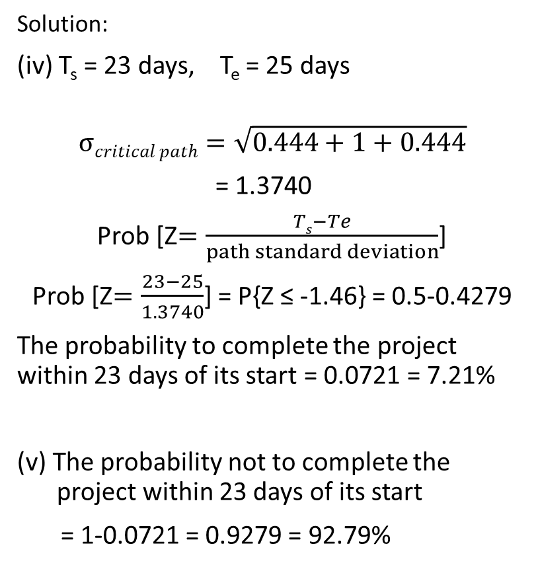
PERT (Example)
Solution:
(iv) T_{s} = 23 days, T_{e} = 25 days
$$σcritical path=\sqrt{0.444+1+0.444}$$
= 1.3740
Prob [Z$=\frac{Ts−Te}{path standard deviation}$]
Prob [Z$=\frac{23−25}{1.3740}$] = P{Z ≤ -1.46} = 0.5-0.4279
The probability to complete the project within 23 days of its start = 0.0721 = 7.21%
(v) The probability not to complete the project within 23 days of its start
= 1-0.0721 = 0.9279 = 92.79%
(vi) The duration of the project that will have 95% chance of being completed
T_{s} = Z$σpath$ + T_{e}
Value of Z at probability 95% = 1.65 (z table)
T_{s} = 1.65x1.3740 + 25 = 27.2671 = 27 days

Slide 48
ADVANTAGES AND LIMITATIONS
ADVANTAGES:
The techniques provide a graphical display of the project and its activities.
Use of these techniques forces the manager to organize and quantify available information and to recognize where additional information is needed.
The techniques identify (a) critical activities that should be closely watched because of the potential for delaying the entire project and (b) noncritical activities that have slack and, therefore, can be delayed without affecting project completion time. This raises the possibility of reallocating resources in order to shorten the project.

Slide 49
ADVANTAGES AND LIMITATIONS
LIMITATIONS:
In developing the project network, one or more important activities may be omitted.
Precedence relationships may not all be correct as shown.
Time estimates usually include a fudge factor: Managers feel uncomfortable about making time estimates because they appear to commit themselves to completion within a certain time period.
The use of computer is essential for large projects.

Slide 50
PROJECT TIME-COST TRADE-OFF
The project completion time can be reduced by reducing (crashing) the duration of the critical activities.
Crashing of duration of critical activities to reduce the project completion time would certainly require additional resources (cost).
Time-Cost relationship is shown in the Figure.
Duration of the activity cannot be reduced beyond Crash Point.
The decision maker may be interested to reduce the project completion time at minimum additional cost.
Direct Cost
Crash Point
Crash Cost (C_{c})
Assumed Linear cost-time relationship
Normal Point
Normal Cost (C_{N})
0
Time
Crash Time (D_{c})
Normal Time (D_{N})

Slide 51
PROJECT TIME-COST TRADE-OFF
Activities on the critical path are potential candidates for crashing because shortening noncritical activities would not have an impact on total project duration.
From economic standpoint the critical activities having lowest cost slope should be crashed first. Crashing should continue as long as the cost to crash is less than the possible benefits from crashing (e.g. incentives for early completion of the project, savings in indirect costs, or both).
The general procedure of crashing:
Step 1: Determine the normal project duration and associated critical path.
Step 2: Calculate cost slope for each critical activity using the relationship
Cost slope = (Crash Cost – Normal Cost) / (Normal Time – Crash Time)
Step 3: Crashing of critical activities will be carried out in order of increasing costs as long as crashing costs do not exceed benefits. Start crashing the critical activity having lowest cost slope among critical activities.
As the original critical path becomes shorter, two or more paths may become critical. In such cases further reduction in duration will require simultaneous shortening of all critical paths by same duration. In some cases it may be economical to shorten a common critical activity on two or more of the critical paths, if crashing cost for a common activity is less than the sum of crashing costs of crashing activities on each separate critical path.
Step 4: Determine total project cost corresponding to each crashing activity.
Step 5: Terminate the procedure when the project completion duration reaches to its desired level or each critical activity has been crashed to its crash time.

Slide 52
PROJECT TIME-COST TRADE-OFF (Example)
The data on time and cost of a project’s activities are shown below:
The indirect cost is Rs. 400 per day. Find the optimum duration and the associated minimum project cost.
Network Diagram with Normal Time:
Activity | Immediate Predecessor | Normal |  | Crash
 |  | Duration (Weeks) | Cost (Rs.,000) | Duration (Weeks) | Cost (Rs.,000)
A | - | 10 | 20 | 7 | 30
B | - | 8 | 15 | 6 | 20
C | B | 5 | 10 | 4 | 14
D | B | 6 | 11 | 4 | 15
E | B | 8 | 9 | 5 | 15
F | E | 5 | 5 | 4 | 8
G | A,D,C | 12 | 3 | 8 | 4
 |  |  | 73000
ET₄ | 14
LT₄ | 14
ET₁ | 0
LT₁ | 0
4
A-10
0
G-12
ET₆ | 26
LT₆ | 26
3
1
C-5
ET₃ | 14
LT₃ | 14
D-6
6
B-8
F-5
2
E-8
5
ET₂ | 8
LT₂ | 8
ET₅ | 16
LT₅ | 21
Critical Path: 1-2-3-4-6

Slide 53
PROJECT TIME-COST TRADE-OFF (Example)
Activity | Normal |  | Crash |  | Cost Slope (Rs.,000 /week)
 | Duration (Weeks) | Cost (Rs.,000) | Duration (Weeks) | Cost (Rs.,000)
A | 10 | 20 | 7 | 30 | 3.33
B | 8 | 15 | 6 | 20 | 2.5
C | 5 | 10 | 4 | 14 | 4
D | 6 | 11 | 4 | 15 | 2
E | 8 | 9 | 5 | 15 | 2
F | 5 | 5 | 4 | 8 | 3
G | 12 | 3 | 8 | 4 | 0.25
 |  | 73000
Network Diagram with Normal Time:
ET₄ | 14
LT₄ | 14
ET₁ | 0
LT₁ | 0
4
A-10
0
G-12
ET₆ | 26
LT₆ | 26
3
1
C-5
ET₃ | 14
LT₃ | 14
D-6
6
B-8
F-5
2
E-8
5
ET₂ | 8
LT₂ | 8
Project Duration = 26 weeks
Project Cost = Direct Cost + Indirect Cost for 26 weeks
= 73000 + 26x7x400 = Rs. 145800
ET₅ | 16
LT₅ | 21
Critical Path: 1-2-3-4-6

Slide 54
PROJECT TIME-COST TRADE-OFF (Example)
Iteration 0: Critical Path = 1-2-3-4-6;
Project Duration = 26 weeks
Project Cost = Direct Cost + Indirect Cost for 26 weeks
= 73000 + 26x7x400 = Rs. 145800
Iteration 1: The cost slope of critical activity G is lowest i.e. Rs. 0.25*1000
= Rs. 250 per week.
It can be crashed by 4 weeks. Crash it by 4 weeks.
Critical Path = 1-2-3-4-6; Project Duration = 22 weeks
Project Cost = Direct Cost + Increase in cost due to crashing + Indirect Cost for 22 weeks
= 73000 + [250*4] + 22x7x400 = Rs. 135600
Network Diagram (Iteration 1):
ET₄ | 14
LT₄ | 14
ET₁ | 0
LT₁ | 0
4
A-10
0
G- 12 8
ET₆ | 22
LT₆ | 22
3
1
C-5
ET₃ | 14
LT₃ | 14
D-6
6
B-8
F-5
2
E-8
5
ET₂ | 8
LT₂ | 8
ET₅ | 16
LT₅ | 17

Slide 55
PROJECT TIME-COST TRADE-OFF (Example)
Iteration 2: No further reduction is possible in activity G.
The cost slope of critical activity D is second lowest i.e.
Rs. 2*1000 = Rs. 2000 per week.
Activity D can be crashed by 2 weeks. But will be crashed by 1 week (as new critical path is being created).
Project Duration = 21 weeks
Project Cost = Direct Cost + Increase in cost due to crashing + Indirect Cost for 21 weeks
= 73000 + [250*4 + 2000*1] + 21x7x400
= Rs. 134800
New Critical Paths:
1-2-4-6; 1-2-3-4-6; 1-2-5-6
Network Diagram (Iteration 2):
ET₄ | 13
LT₄ | 13
ET₁ | 0
LT₁ | 0
4
A-10
0
G- 12 8
ET₆ | 21
LT₆ | 21
3
1
C-5
ET₃ | 13
LT₃ | 13
D-6 5
6
B-8
F-5
2
E-8
5
ET₂ | 8
LT₂ | 8
ET₅ | 16
LT₅ | 16

Slide 56
PROJECT TIME-COST TRADE-OFF (Example)
Iteration 3: New Critical Paths: 1-2-4-6; 1-2-3-4-6; 1-2-5-6
To reduce the project duration all critical paths should be crashed simultaneously. Activity B is common in all three critical paths and crashing this activity is less costly than crashing critical activities on each path simultaneously.
The cost slope of critical activity B = Rs. 2500 per week.
It can be crashed by 2 weeks. Crash it by 2 weeks.
Project Duration = 19 weeks
Project Cost = 73000 + [250*4 + 2000*1 + 2500*2] + 19x7x400 = Rs. 134200
Network Diagram (Iteration 3):
ET₄ | 11
LT₄ | 11
ET₁ | 0
LT₁ | 0
4
A-10
0
G- 12 8
ET₆ | 19
LT₆ | 19
3
1
C-5
ET₃ | 11
LT₃ | 11
D-6 5
6
B-8 6
F-5
2
E-8
5
ET₂ | 6
LT₂ | 6
ET₅ | 14
LT₅ | 14

Slide 57
PROJECT TIME-COST TRADE-OFF (Example)
Iteration 4: Critical Paths: 1-2-4-6; 1-2-3-4-6; 1-2-5-6
To reduce the project duration all critical paths should be crashed simultaneously. No further reduction is possible in B and G as they are at their crash time. Further possible crashing is:
Overall reduction is 1 week only.
Project Duration = 18 weeks
Project Cost = 73000 + [250*4 + 2000*1 + 2500*2 + (4000+2000+2000)]+18x7x400
= Rs. 139400
Critical Paths: 1-2-4-6; 1-2-3-4-6; 1-2-5-6; 1-4-6
The project cost has increased from last iteration, stop, this reduction is not desirable.
Network Diagram (Iteration 4):
ET₄ | 10
LT₄ | 10
Path | Crashing Activity | Crashing Duration | Additional Cost
1-2-4-6 | C | 1 | 4000
1-2-3-4-6 | D | 1 | 2000
1-2-5-6 | E | 1 | 2000
ET₁ | 0
LT₁ | 0
4
A-10
0
G- 12 8
ET₆ | 18
LT₆ | 18
3
1
C-5 4
ET₃ | 10
LT₃ | 10
D-6 5 4
6
B-8 6
F-5
2
E-8 7
5
ET₂ | 6
LT₂ | 6
ET₅ | 13
LT₅ | 13

Slide 58
PROJECT TIME-COST TRADE-OFF (Example)
SUMMARY:
Network Diagram (Optimum):
Iteration | Project Duration (Weeks) | Project Cost (Rs.)
0 | 26 | 245800
1 | 22 | 135600
2 | 21 | 134800
3 | 19 | 134200
4 | 18 | 139400
ET₄ | 11
LT₄ | 11
ET₁ | 0
LT₁ | 0
4
A-10
0
G- 12 8
ET₆ | 19
LT₆ | 19
3
1
C-5
ET₃ | 11
LT₃ | 11
D-6 5
6
B-8 6
F-5
2
E-8
5
Optimum Project Duration = 19 weeks
Project Cost = Rs. 134200
ET₂ | 6
LT₂ | 6
ET₅ | 14
LT₅ | 14

Slide 59
Thank You!
Dr. V.B.Gupta
+ 91 99933 50547
vbgupta.davv@gmail.com

